Slide 1
Version Control using Git
Git is an open source, distributed version control system designed for speed and efﬁciency

Slide 2


What is Git?
Git is a distributed version control and source code management(SCM) system
- Speed, Data integrity and support for distributed, non-linear workflows.
Initially designed and developed by Linus Torvalds for Linux kernel development in 2005
Full-fledged repository with complete history
Full version-tracking capabilities, independent of network access or a central server.
Git is free software distributed under the terms of the GNU General Public License version 2.
Source Code repository
Developers

Slide 3
Version control systems
Strengths
Best for
Centralized Version Control
Check-in Check-out
Fine level permission control
Allows usage monitoring
Large integrated codebases
Control and auditability over source code down to the file level
Edit Commit
Offline editing support
Easy to edit files outside Visual Studio or Eclipse
Medium-sized integrated codebases
A balance of fine-grained control with reduced friction
Distributed
Version Control (DVCS)
Fast offline experience
Complete repository with portable history
Flexible advanced branching model
Modular codebases
Integrating with open source
Highly distributed teams

Slide 4
Design Base
Git’s design was inspired by BitKeeper and Monotone.
Originally designed as a low-level version control system engine on top of which others could write front ends, such as Cogito.
The core Git project has since become a complete version control system that is usable directly.
While strongly influenced by BitKeeper, Torvalds deliberately attempted to avoid conventional approaches, leading to a unique design.

Slide 5
Git Characteristics
Strong support for non-linear development
Rapid branching and merging, and includes specific tools for visualizing and navigating a non-linear development history.
Branches in git are very lightweight: A branch in git is only a reference to a single commit. With its parental commits, the full branch structure can be constructed.
Distributed development
Like Darcs, BitKeeper, Mercurial, SVK, Bazaar and Monotone, Git gives each developer a local copy of the entire development history, and changes are copied from one such repository to another. These changes are imported as additional development branches, and can be merged in the same way as a locally developed branch.
Compatibility with existing systems/protocols
Repositories can be published via HTTP, FTP, rsync, or a Git protocol over either a plain socket, or ssh. Git also has a CVS server emulation, which enables the use of existing CVS clients and IDE plugins to access Git repositories. Subversion and svk repositories can be used directly with git-svn.

Slide 6
Git Characteristics
Efficient handling of large projects
Cryptographic authentication of history
Toolkit-based design
Pluggable merge strategies
Garbage accumulates unless collected
Periodic explicit object packing
Notes:
Efficient handling of large projects
Torvalds has described Git as being very fast and scalable and performance tests done by Mozilla showed it was an order of magnitude faster than some version-control systems, and fetching version history from a locally stored repository can be one hundred times faster than fetching it from the remote server
Cryptographic authentication of history
The Git history is stored in such a way that the ID of a particular version (a commit in Git terms) depends upon the complete development history leading up to that commit. Once it is published, it is not possible to change the old versions without it being noticed. The structure is similar to a Merkle tree, but with additional data at the nodes as well as the leaves.(Mercurial and Monotone also have this property.)
Toolkit-based design
Git was designed as a set of programs written in C, and a number of shell scripts that provide wrappers around those programs. Although most of those scripts have since been rewritten in C for speed and portability, the design remains, and it is easy to chain the components together.
Pluggable merge strategies
As part of its toolkit design, Git has a well-defined model of an incomplete merge, and it has multiple algorithms for completing it, culminating in telling the user that it is unable to complete the merge automatically and that manual editing is required.
Garbage accumulates unless collected
Aborting operations or backing out changes will leave useless dangling objects in the database. These are generally a small fraction of the continuously growing history of wanted objects. Git will automatically perform garbage collection when enough loose objects have been created in the repository. Garbage collection can be called explicitly using git gc—p run.
Periodic explicit object packing
Git stores each newly created object as a separate file. Although individually compressed, this takes a great deal of space and is inefficient. This is solved by the use of packs that store a large number of objects in a single file (or network byte stream) called packfile, delta-compressed among themselves.

Slide 7
Git Server
As git is a distributed version control system, it can be used as server out of the box. Dedicated git server software helps, amongst other features, to add access control, display the contents of a git repository via web, and help managing multiple repositories.
Remote file store and shell access
Gitdaemon, instaweb
Gitolite
Gerrit
Gitblit
Gitiles
Bonobo GitServer
Commercial solutions
Notes:
Remote file store and shell access
A gitrepository can be cloned to a shared file system, and accessed by other persons. It can also be accessed via remote shell just by having the gitsoftware installed and allowing a user to log in.
Gitdaemon, instaweb
Gitdaemon allows users to share their own repository to colleagues quickly. Gitinstaweballows users to provide web view to the repository. As of 2014-04 instawebdoes not work on Windows. Both can be seen in the line of Mercurial's"hg serve".
Gitolite
Gitoliteis an access control layer on top of git, providing fine access control to gitrepositories. It relies on other software to remotely view the repositories on the server.
Gerrit
Gerritprovides two out of three functionalities: access control, and managing repositories. It uses jGit. To view repositories it is combined e.g. with Gitilesor GitBlit.
Gitblit
Gitblitcan provide all three functions, but is in larger installations used as repository browser installed with gerritfor access control and management of repositories.
Gitiles
Gitilesis a simple repository browser, usually used together with gerrit.
Bonobo GitServer
Bonobo GitServer is a simple gitserver for Windows implemented as an ASP.NET gateway.Itrelies on the authentication mechanisms provided by Windows Internet Information Services, thus it does not support SSH access but can be easily integrated with Active Directory.
Commercial solutions
Commercial solutions are also available to be installedon premises, amongst themGitHubSoftware (using native git, available as a vm),Stash(using jGit),Team Foundation Server(using libgit2).

Slide 8
Git : Benefits
Distributed : local & remote repositories
No Network Needed for
Performing Diff
Viewing file history
Committing changes
Merging branches
Switching branches
Immutable
Snapshots over patches

Slide 9
Git Basics
Commit
Branch
Tags
Local Repository
Remote Repository

Slide 10
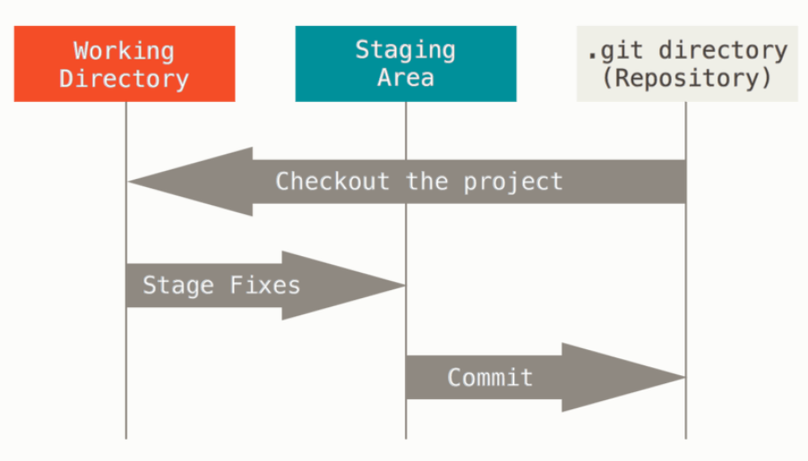
Git : Workspace

Slide 11
Git : Installation
Available on Linux
Available on MacOS
Available on Windows
Git for Windows (Installer)
Portable Git
Both Versions available at
https://git-scm.com/download/win

Slide 12
Git : One time setup
Being a distributed version control system, need to identify current user through config:
$ git config --global user.name “omprakash”
$ git config --global user.email “omspandey@hotmail.com”

Slide 13
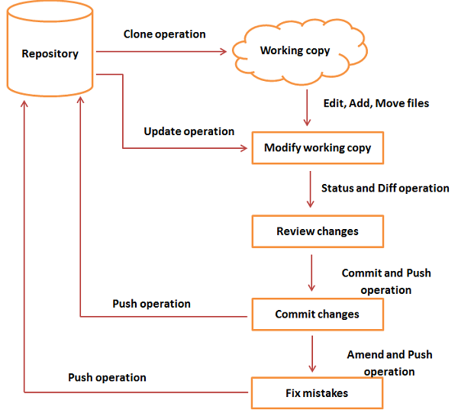
Git Work flow

Slide 14
Git : Typical Workflow
Edit files
Stage changes
Review changes
Commit changes
Push to remote
Working Directory
$ git add
Index
$ git commit
Repository (Local)
$ git push

Slide 15
Git Working with new repository
Create a new empty repository
$ git init
Add files
Create files using favourite editor and save in current directory
Stage / Index files
$ git add .
Commit changes
$ git commit –m “Initial change!”

Slide 16
Git Hub Registration
A hosted service for remote git repositories.
Unlimited PUBLIC repositories for Open source projects.
Widely popular with Open Source community.
Even Linus Torvalds has complete Linux Kernel source on GitHub!
Visit https://github.com

Slide 17
Git Cloning
Clone remote repository as local one
$ git clone <remote-repo-url>
Save changes to local
$ git commit –m “Updated stuff!”
Upload local changes to remote (Need user credentials)
$ git push

Slide 18
Git Branches
A "branch" is an active line of development.
The most recent commit on a branch is referred to as the tip of that branch.
The tip of the branch is referenced by a branch head, which moves forward as additional development is done on the branch.
A single git repository can track an arbitrary number of branches, but your working tree is associated with just one of them (the "current" or "checked out" branch), and HEAD points to that branch

Slide 19
Git Branches
Getting different versions of project:
Git is best thought of as a tool for storing the history of a collection of files. It stores the history as a compressed collection of interrelated snapshots of the project’s contents. In git each such version is called a commit.
Those snapshots aren’t necessarily all arranged in a single line from oldest to newest; instead, work may simultaneously proceed along parallel lines of development, called branches, which may merge and diverge.
A single git repository can track development on multiple branches. It does this by keeping a list of heads which reference the latest commit on each branch; the git-branch(1) command shows you the list of branch heads:
$ git branch * master
A freshly cloned repository contains a single branch head, by default named "master", with the working directory initialized to the state of the project referred to by that branch head.
Most projects also use tags. Tags, like heads, are references into the project’s history, and can be listed using thegit-tag(1) command:
$ git tag -l

Slide 20
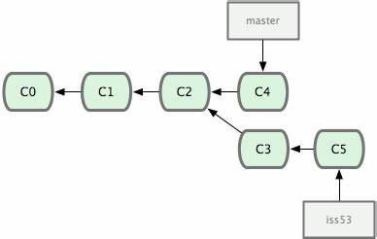
Git Branching
Isolate work units
Long running topics
Branch is JUST a POINTER to Commit!!
Default branch name : “master”
Commands:
$ git branch
$ git checkout
$ git merge

Slide 21
Understanding History - Commits
Every change in the history of a project is represented by a commit. The git-show(1) command shows the most recent commit on the current branch:
$ git show
Every commit (except the very first commit in a project) also has a parent commit which shows what happened before this commit. Following the chain of parents will eventually take you back to the beginning of the project.
However, the commits do not form a simple list; git allows lines of development to diverge and then reconverge, and the point where two lines of development reconverge is called a "merge".
The commit representing a merge can therefore have more than one parent, with each parent representing the most recent commit on one of the lines of development leading to that point.
The best way to see how this works is using the gitk(1)command; running gitk now on a git repository and looking for merge commits will help understand how the git organizes history.
In the following, we say that commit X is "reachable" from commit Y if commit X is an ancestor of commit Y. Equivalently, you could say that Y is a descendant of X, or that there is a chain of parents leading from commit Y to commit X.

Slide 22
Git : Other common commands
Git status
Git diff
Git log
Git fetch
Git pull

